Slide 1


Team 6: Telescope Autofocuser
Bi-Weekly Update 3 Albin Myscich
Alonna Too-Chiobi
Camille Watson
Joseph Basdeo
Sponsor: Dr. Kevin Nowka
TA: Max Lesser
Notes:
Michelle

Slide 2
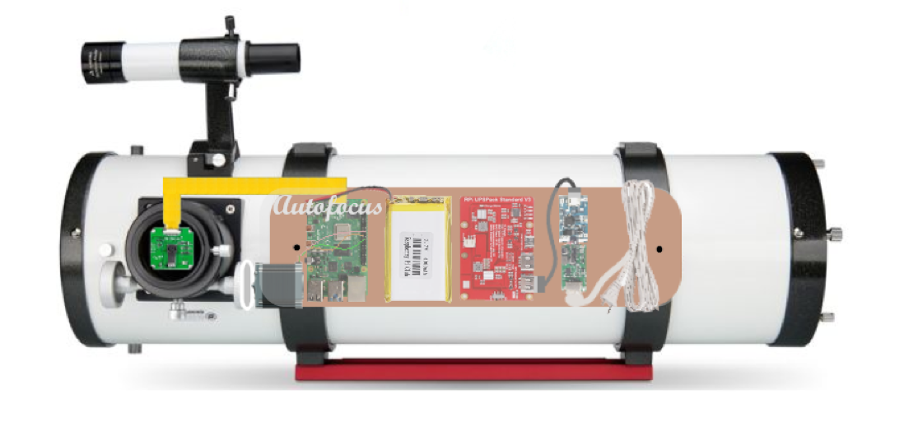
Project Summary
Telescope focusing & image processing automation
Product Will:
Stream current images to dev board using an imager
Autofocus using a stepper motor interface
Display focused image post processing through a GUI
Notes:
Kyle

Slide 3
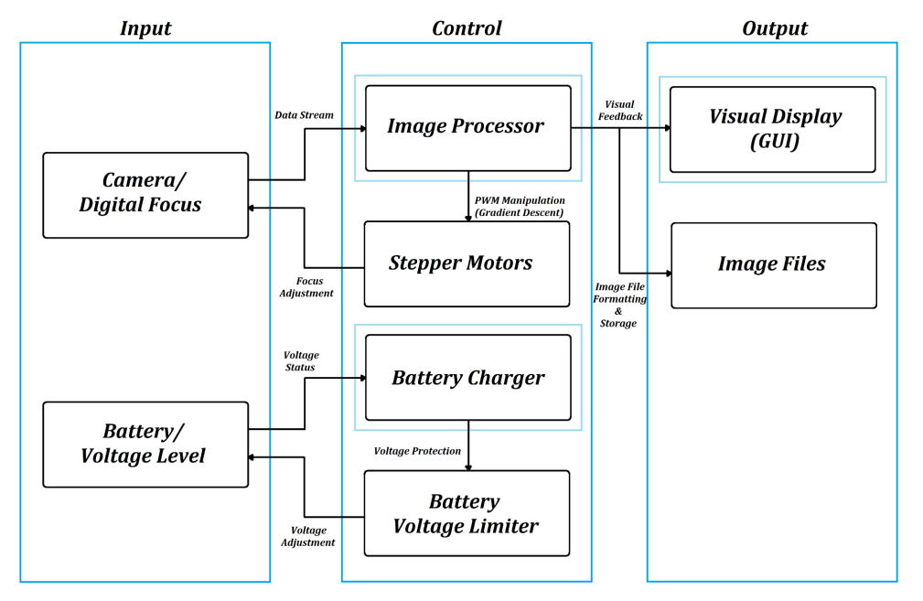
Project/Subsystem Overview
Albin
Alonna
Camille
Joseph
Notes:
Here is a refresher on how the different subsystems relate to each other. Nothing has changed since our first presentation. The camera is still communicating with the image processor who is talking to the GUI, image files, and stepper motors; and the battery is still communicating with the charger who is communicating with the voltage limiter who is then talking back to the battery.

Slide 4
Project Timeline
Subsystem Designs and Testing (completed 4/21) | Integration of Motors, Autofocusing Program, and Imager Subsystems (to completed by 10/7) | Integration of Image Processor and GUI (to completed by 10/14) | Integration of Power Supply with all Dependent Subsystems (to completed by 10/14) | Final Integration (to complete by 10/28) | System Test (to complete by 11/11) | Validation (to complete by 11/28) | Demo and Report (to complete by 12/2)

Slide 5
Motor Assembly
Alonna Too-Chiobi
Accomplishments since last update 16.5 hrs of effort | Ongoing progress/problems and plans until the next presentation
Completed the assembly of Celestron Equatorial Mount Issue(s): Load is too heavy to be properly balanced Potential resolution(s) Obtain or fabricate “dovetail” clamp brackets Obtain heavier counter-weight | Ongoing integration of Imager and Motor assembly subsystems Purpose: Obtain data displaying imager’s ability to capture images as motor rotates focuser to specified step counts Issue(s): Heavier load Visual discrepancies due to integrated position Result(s): Pending…
Notes:
Heavier load

Slide 6
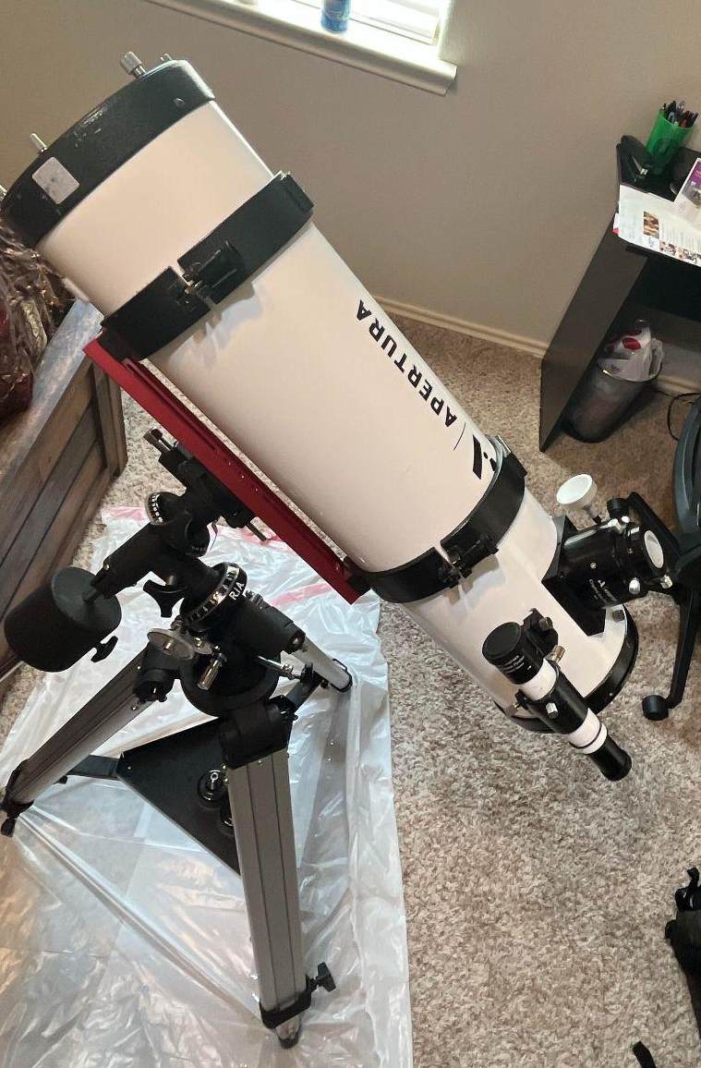
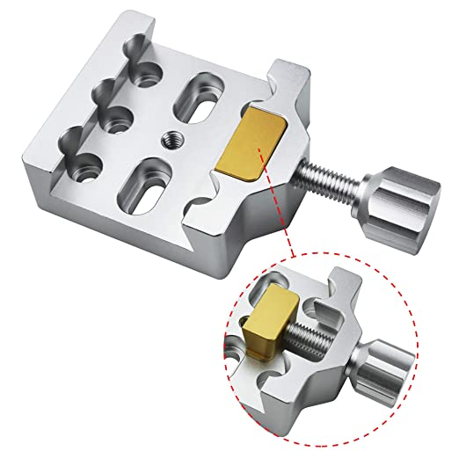
Motor Assembly
Alonna Too-Chiobi
Dovetail Mount
Telescope Apparatus

Slide 7
Imager & Mounting Assembly
Joseph Basdeo
Accomplishments since last update 20 hrs of effort | Ongoing progress/problems and plans until the next presentation
Calibrated telescope Redesigned and tested imager mount to accommodate telescope movement Gathered data to test autofocusing program Fabricated aluminum motor coupler | Ongoing integration with motor subsystem Begin GUI and system program integration Gather data of space objects rather than ground objects

Slide 8

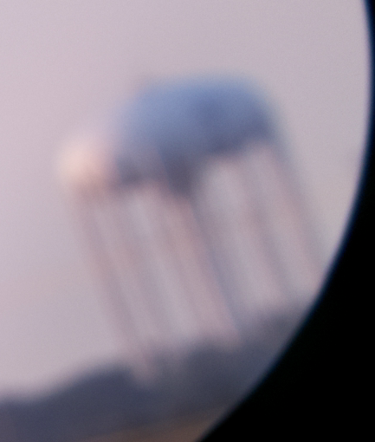
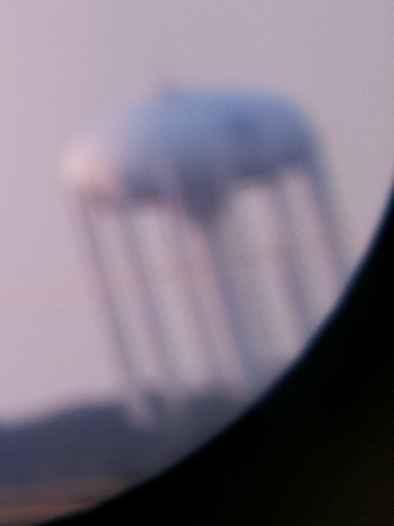
Imager & Mounting Assembly
Joseph Basdeo

Slide 9
Power Supply
Camille Watson
Accomplishments since last update 6 hrs of effort | Ongoing progress/problems and plans until the next presentation
Resolved all DFM violations and validated PCB on Altium Requested order of PCB through the Business department | Practice unsoldering and soldering PCB Use previous breadboard version of circuit for integration testing

Slide 10
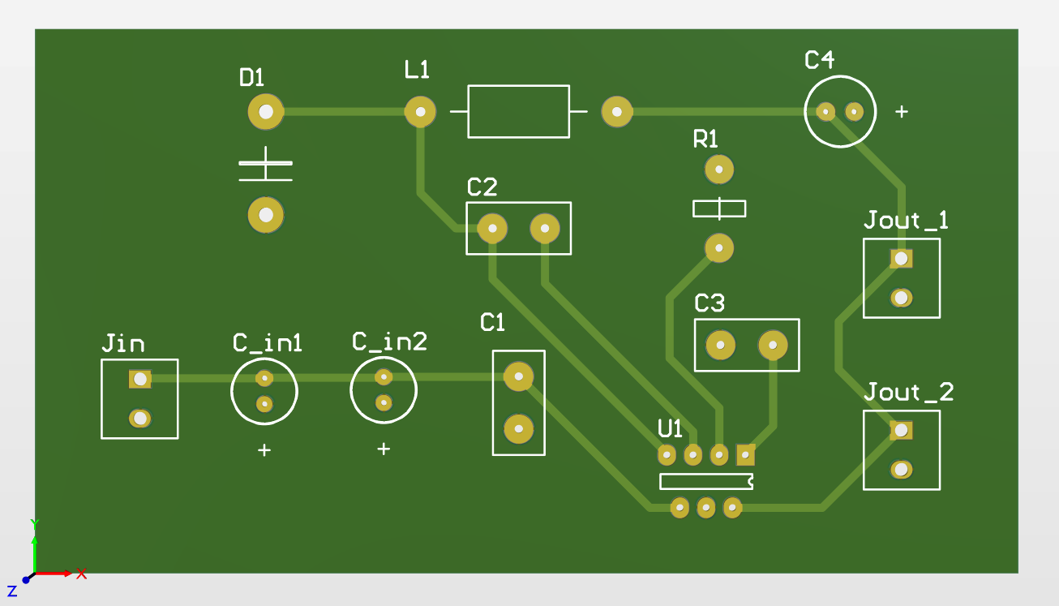
Power Supply
Camille Watson
Final Design of Buck Converter PCB

Slide 11
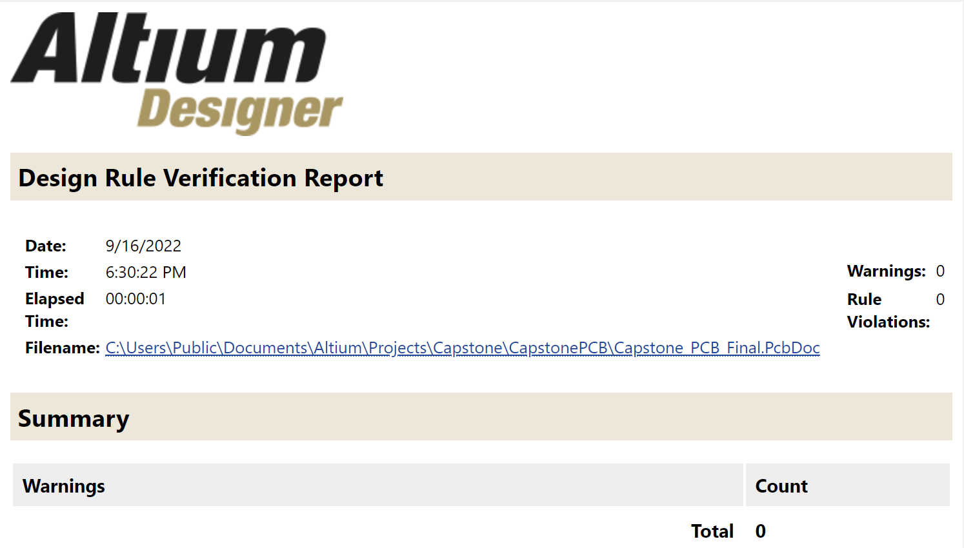
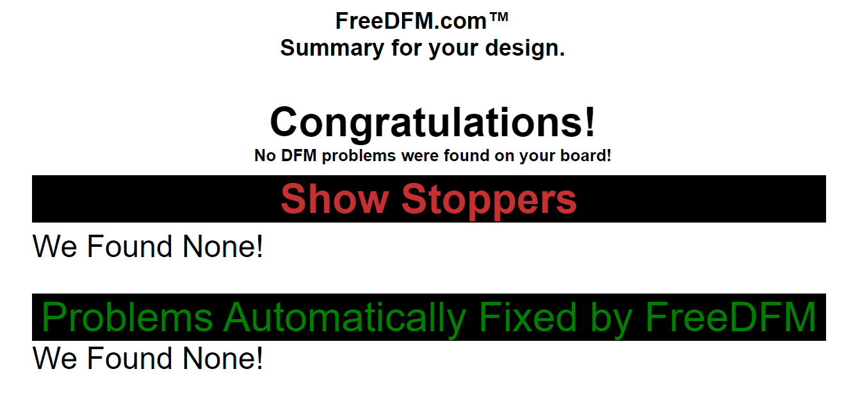
Power Supply
Camille Watson
Advanced Circuits DFM Results
Altium Designer Verification Report

Slide 12
Image Processing & Autofocusing Program
Albin Myscich
Accomplishments since last update 24 hrs of effort | Ongoing progress/problems and plans until the next presentation
System agnostic navigation/interaction DRY code for easy debug and integration to GUI Added 200+ new images to training data Finalize autofocus-motor control interactions Step count/stride focus | Interlink motor controls directly to auto-focus software Interlink auto-focus software to GUI Fine tune autofocus threshold in practical application Remove Stride Reset

Slide 13
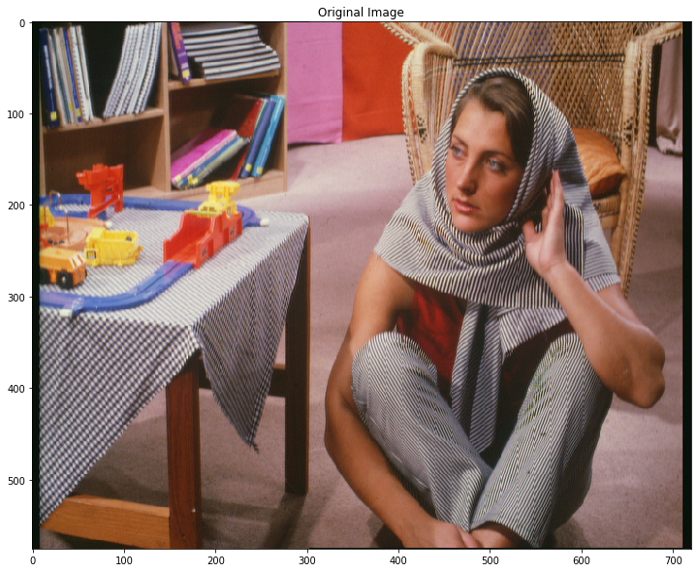
Image Distortion/Prediction
Notes:
SSIM is a perception-based model that considers image degradation as perceived change in structural information, while also incorporating important perceptual phenomena, including both luminance masking and contrast masking terms. The difference with other techniques such as MSE or PSNR is that these approaches estimate absolute errors.

Slide 14

Image Distortion/Prediction
PSNR: 25.804217868496153
MSE: 512.6014274691358
SSIM: 0.7967242506776445
Injected loss via generation loss:
Scaled down and up by factor of 2
INTER_CUBIC
A bicubic interpolation over 4×4 pixel neighborhood
PSNR - Peak signal-to-noise ratio
MSE - Mean squared error
SSIM - structural similarity index measure
Notes:
SSIM is a perception-based model that considers image degradation as perceived change in structural information, while also incorporating important perceptual phenomena, including both luminance masking and contrast masking terms. The difference with other techniques such as MSE or PSNR is that these approaches estimate absolute errors.

Slide 15

Image Distortion/Prediction
PSNR: 26.432215326919476
MSE: 443.5883101851852
SSIM: 0.8434364090355023
PSNR - Peak signal-to-noise ratio
MSE - Mean squared error
SSIM - structural similarity index measure
Notes:
SSIM is a perception-based model that considers image degradation as perceived change in structural information, while also incorporating important perceptual phenomena, including both luminance masking and contrast masking terms. The difference with other techniques such as MSE or PSNR is that these approaches estimate absolute errors.

Slide 16
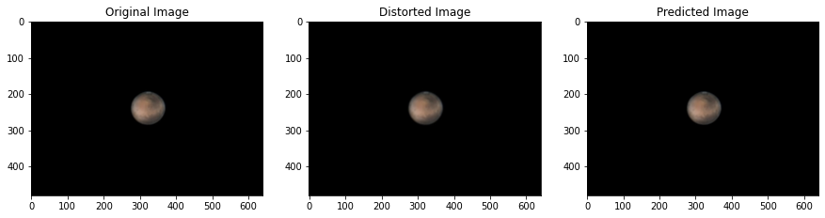
Image Distortion/Prediction
Original/Distorted:
PSNR: 62.3994; MSE: 0.2341; SSIM: 0.9996
Original/Predicted:
PSNR: 59.2085; MSE: 0.1122; SSIM: 0.9997

Slide 17
Autofocus Selection Example
Step 2
Step 3
Step 1
Step 1
Stride 1 (0॰)
Stride 2 (120॰)
Stride 3 (240॰)
Next iteration optimizes step 2 to best stride frame reset

Slide 18
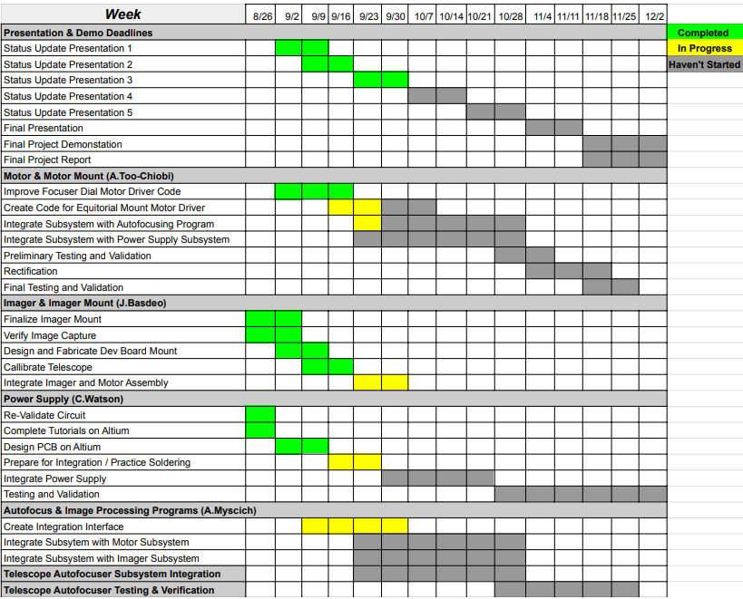
Execution & Validation Plan
Notes:
Michelle

Slide 19
Thank You
Questions?

